Slide 1
Dr Manjunatha S
College of Computer and Information Science
Majmaah University
Almajmaah

Slide 2
CURRENT TRENDS IN SCIENCE AND TECHNOLOGY

Slide 3
Agenda
Introduction
Hot technology
Conclusion

Slide 4
INTRODUCTION
Nono Science
Biosensor
Self-Driving Cars
Recycling
Magnetic Memory
Networking
Cryptography
RFID

Slide 5
Sensors
Definition:
A device that measures or detects a real world condition, such as motion, heat or light and converts the condition into an analog or digital representation.
A device that measures a physical quantity and converts it into a signal which can be read by an observer or by an instrument.

Slide 6
Classification of Sensors
Mechanical quantities: displacement, Strain, rotation velocity, acceleration, pressure, force/torque, twisting, weight, flow
Thermal quantities: temperature, heat.
Electromagnetic/optical quantities: voltage, current, frequency phase; visual/images, light; magnetism.
Chemical quantities: moisture, pH value

Slide 7
Specifications of Sensor
Accuracy: error between the result of a measurement and the true value being measured.
Resolution: the smallest increment of measure that a device can make.
Sensitivity: the ratio between the change in the output signal to a small change in input physical signal. Slope of the input-output fit line.
Repeatability/Precision: the ability of the sensor to output the same value for the same input over a number of trials

Slide 8
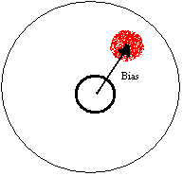
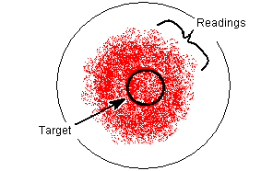
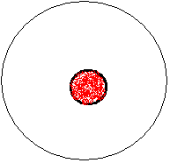
Accuracy vs. Precision
Precision without accuracy
Accuracy without precision
Precision and accuracy

Slide 9
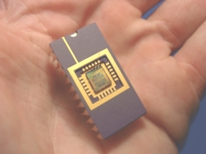
Health Care: Biosensors
A sensor that integrates a biological element with a physiochemical transducer to produce an electronic signal proportional to a single analytic which is then conveyed to a detector.

Slide 10
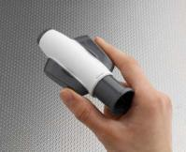
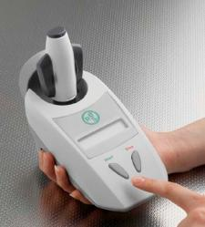
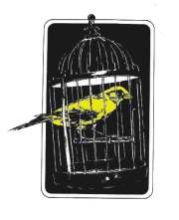
Example of biosensors
Infectous disease biosensor from RBS
Old time coal miners’ biosensor

Slide 11
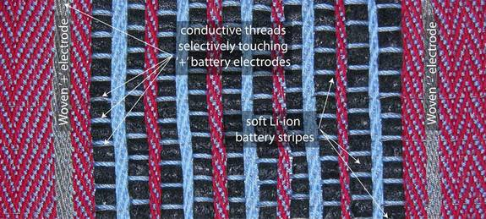
A Canadian lab has tested special fibers that can help make soft, flexible touch screens and batteries woven directly into the fabrics of modern life.

Slide 12
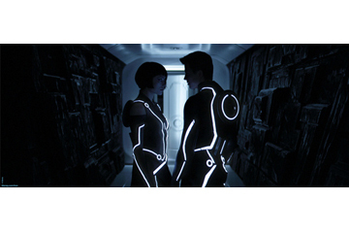
'Smart Clothing' Could Become New Wearable Gadgets

Slide 13
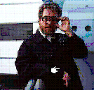
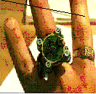
Wearable Biosensors
Ring Sensor
Smart Shirt

Slide 14
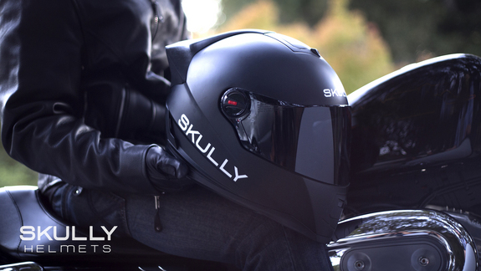
Smart' Helmet Wins Wearable Tech Award at SXSW 2014.
The helmet has a 180-degree rear-view camera that projects images to a transparent headset display, so the driver's eyes can see around them in every direction, while never having to leave the road ahead.

Slide 15
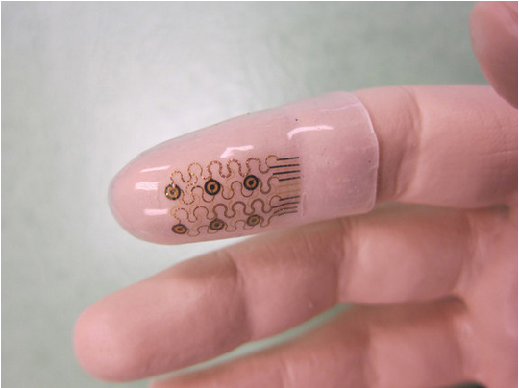
Wearable Electronics Pave Way for Smart Surgeon Gloves, Stretchy electronics can fit fingers or other parts of the human body for medical or athletic applications.

Slide 16
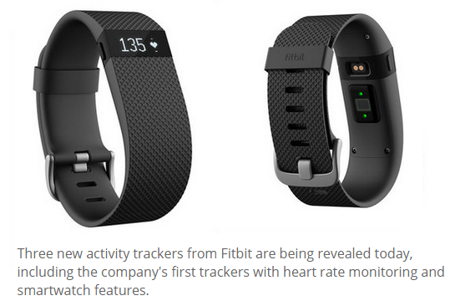
This month, Fit bit released 3 smart watches to read heart beat..

Slide 17
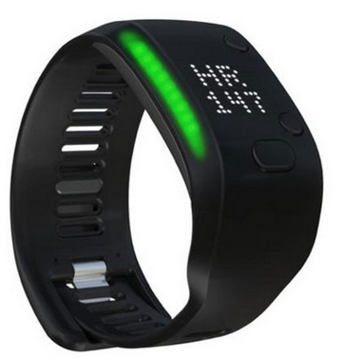
Adidas Fit Smart: releases Fitness Tracker…

Slide 18
Implantable biosensors that track blood glucose levels and deliver insulin.
Microchips is testing a chip implant that offers long-term, time-controlled drug delivery.
Technology expects usage of in-the-flesh physicians within ten years.
Wirelessly controlled biosensor that detects and treats an acute condition, and then a biosensor that will approximate an artificial organ

Slide 19
Presently, biosensors in ENVIRONMENTAL MONITORING stations nationwide can detect compounds like anthrax—but detection can take 12 to 24 hours. The best ones on the market take 20 minutes
Sandia National Lab. developed a system that detects BIO TOXINS in 5 minutes.
Integrate both gas and liquid-based into one handheld device could be incorporated into MILITARY UNIFORMS and eventually into houses as the BIOWAR FARE equivalent of a smoke detector.

Slide 20
Biosensors monitor air quality and emissions at chemical refineries and quality control at food-processing plants.
If funding isn't diverted to military applications, within five to ten years biosensors could be used in food lines to test every product.

Slide 21
MicroChips' Santini, "I'm confident we'll have the biosensor artificial-organ system soon."
Applied Digital Solutions - has even developed a tag called a VeriChip that can be implanted under the skin and contain information about allergies, immunizations, or pacemakers. It could also hold criminal records or security clearances.

Slide 22
  MEMS Technology
  (Micro Electro Mechanical Systems)
  “MEMS is the name given to the practice of making and combining miniaturized mechanical and electrical components.”

Slide 23
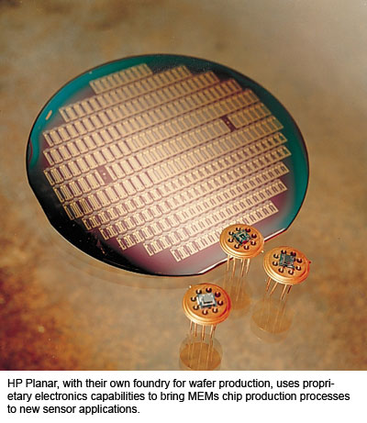
MEMS Technology

Slide 24
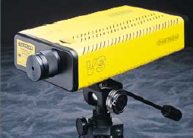
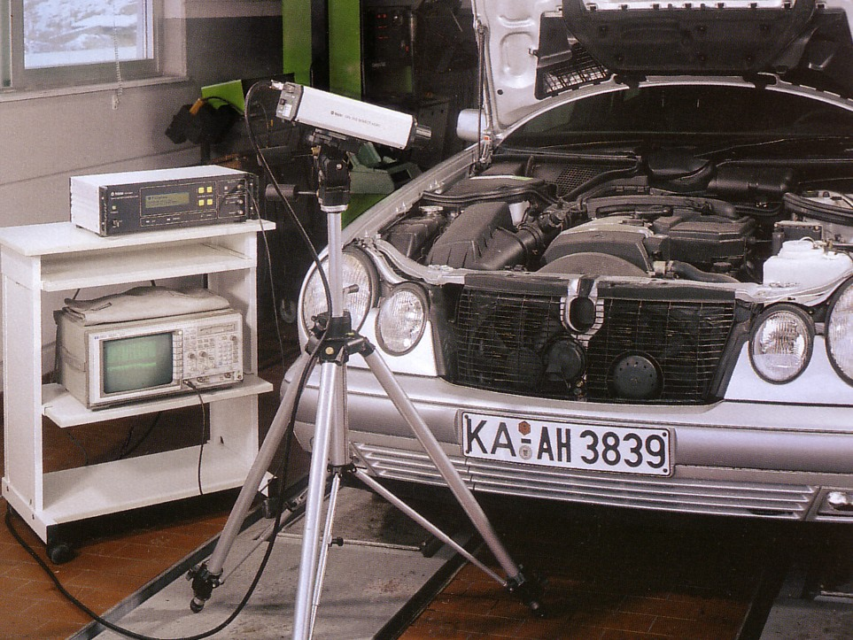
Velocity Sensing
Scanning Laser Vibrometry
  No physical contact with the test object; facilitate remote, mass-loading-free vibration measurements on targets
  measuring velocity (translational or angular)
  automated scanning measurements with fast scanning speed
Photo courtesy of Bruel & Kjaer
Photo courtesy of Polytec

Slide 25
Mobile: Self-Driving Cars
Imagine a 180 KM trip from Almajmaah to Riyadh City, your car travels at 120 Km/hr, unassisted and in complete safety. You're in the driver's seat, but the car does the driving.
Dedicated Short Range Communications (DSRC) network for cars has allocated spectrum at 5.9 GHz.
Stop signs and traffic lights could also be fitted with DSRC transmitters.

Slide 27
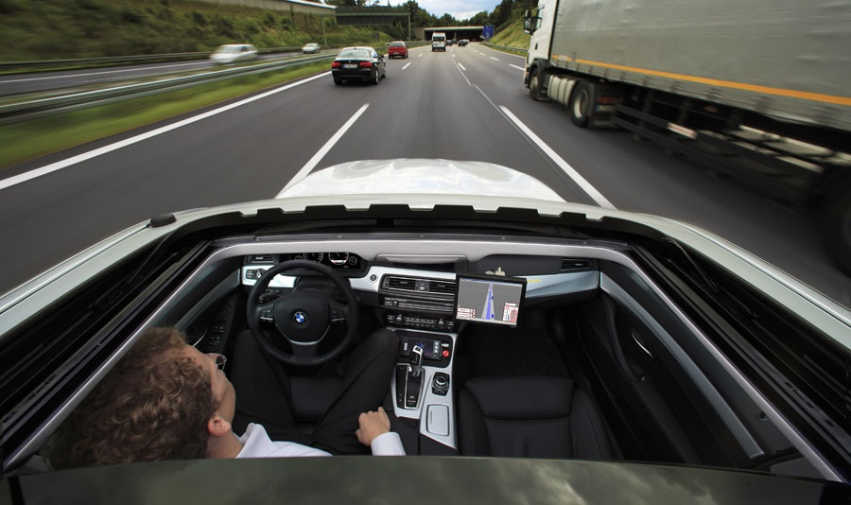

Slide 28
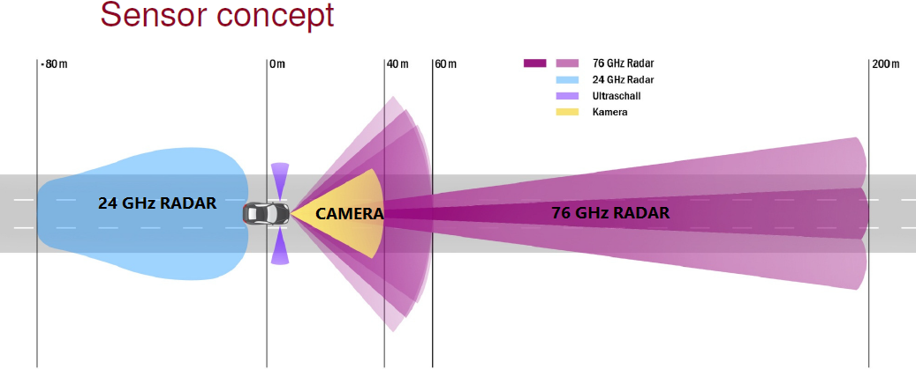
It consists of Ultra precise GPS fixes, Scanner, Google Translator, Lane assistance and Blind spot detection..

Slide 29
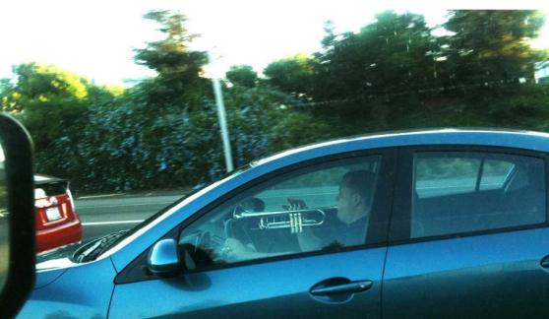

Slide 30
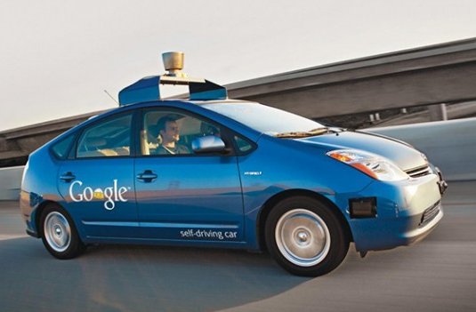

Slide 31
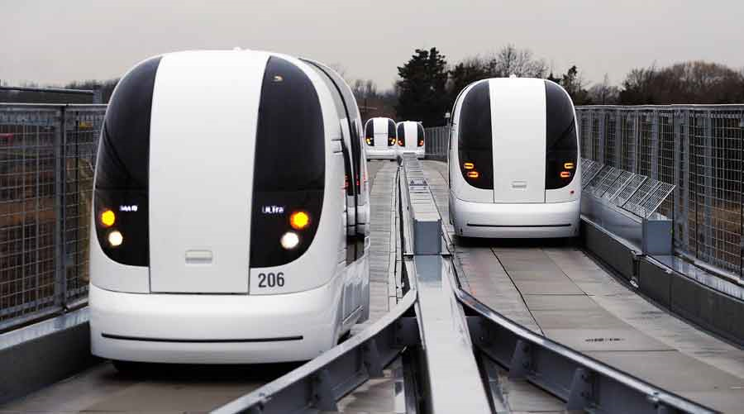
Autonomous cars are already operating at Heathrow airport. The computer-controlled, battery-powered cars automatically drive along a specially prepared road.

Slide 32
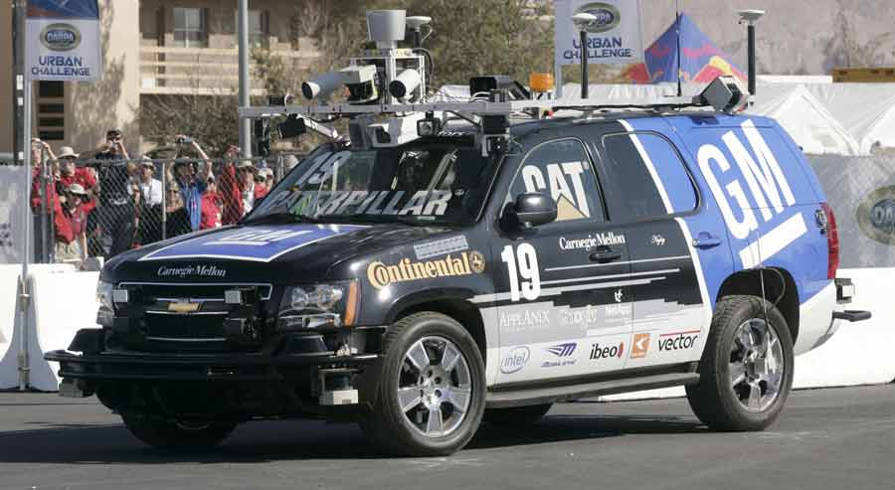
A team including GM and Mellon built the car and it won the Darpa Urban Challenge, a contest in which autonomous vehicles raced without drivers in a simulated urban environment.

Slide 33
Security: Quantum Cryptography
20 years of academic research, two companies have used the principles of quantum mechanics to create the most secure form of computer encryption the world has ever seen.

Slide 34

Telephone hacking
  Use telephone freely
  It’s called phreaking
Computer virus
  Destroy many computers
Network hacking
  Hack the important server remotely and destroy/modify/disclose the information

Slide 35

A new Firefox feature called “Firesheep” can be used to easily hack into a person’s computer over a public Wi-Fi network and gain access to several popular sites, including Facebook, Twitter, and Amazon.

Slide 36
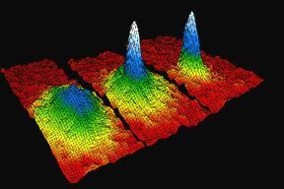
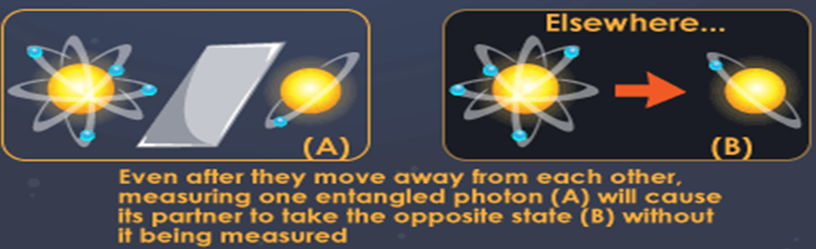
Quantum Computer

Slide 37
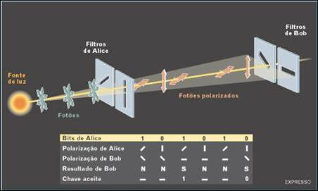

Slide 38
When you exchange quantum keys with someone, you can be sure that no one could ever hope to figure them out. Any e-mail message, telephone call, or financial transaction encrypted with these keys will be safe.
"If there are things that you want to keep protected for another 10 to 30 years, you need quantum cryptography,"

Slide 39
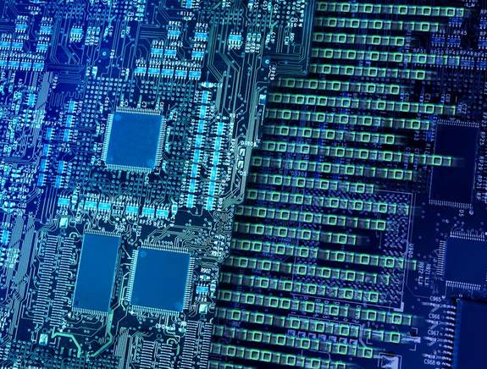
Quantum Network Secretly Running for 2 Years, Tia Ghose, LiveScience, May 08, 2013.
The first economical and scalable quantum cryptography that could be used with existing fiber-optic networks.

Slide 40
Components: Magnetic Memory
MRAM –Magneto Resistive Random Access Memory
Today's PCs use SRAM (static RAM) and DRAM (dynamic RAM), both known as volatile memory. They can store information only if they have power
If an MRAM computer loses power, you can restart it in an instant, and when you do, that four-page e-mail will be right where you left it.

Slide 41
Chia-Ling Chien, a professor of physics in the Krieger School of Arts and Sciences at Johns Hopkins University, whose research has long focused on magnetic structures. "Several thousand times a second, you have to reload them, or they go away.”

Slide 42
MRAM stores bits as magnetic polarities rather than electrical charges.
MRAM bits are made from magnetized metal material.
When a bit's polarity points in one direction, it holds as 1, when its polarity points in another direction, it holds as 0. The bits need electricity to change polarities but not to maintain them.
MRAM is nonvolatile, so when you turn off the power, all the bits retain their 1's and 0's.

Slide 43
MRAM could let developers reinvent other parts of a PC as well. Potentially much faster than the continuous magnetic media inside today's hard drives, it may lead to better mass storage devices.

Slide 44
Wireless: Radio-Frequency ID Tags
Radio-frequency Identification (RFID) are tiny tags containing a microprocessor, an antenna, and an identification code are embedded in items.
RFID goes back to World War II, when researchers created a system to reduce "friendly fire" incidents by beaming radio signals to an aircraft's transponder. Over time, the transponders, or tags, got smaller, cheaper, and more sophisticated, and RFID”s.

Slide 45

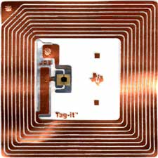
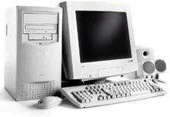
What is RFID? How RFID works?
Activation Signal
Data
Data

Slide 46
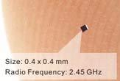
New Tracking Chip Size of a Dust Grain: 0.05 x 0.05 millimeters. "RFID“ chip (The world's smallest and thinnest tags by Hitachi). It is use a tiny antenna to transfer small amounts of data for identification purposes. It can call as TATO tag

Slide 47
RFID
The new RFID chips have a 128-bit ROM for storing a unique 38 digit number. Hitachi used semiconductor miniaturization technology and electron beams to write data on the chip.
Hitachi's mu-chips are already in production; they were used to prevent ticket forgery at last year's Aichi international technology exposition. RFID 'powder,' on the other hand, is so much smaller that it can easily be incorporated into thin paper, like that used in paper currency and gift certificates.

Slide 48
RFID-Booming markets
Analysts: tremendous market-growth
Problem: estimates vs. guesstimates (remarkable differences in market volume, growth rates)
Frost & Sullivan: 11.7 billion USD (2010)
Research and Markets: 3.8 billion USD (2011)
IDTechEx: 26.90 billion USD (2015)

Slide 49
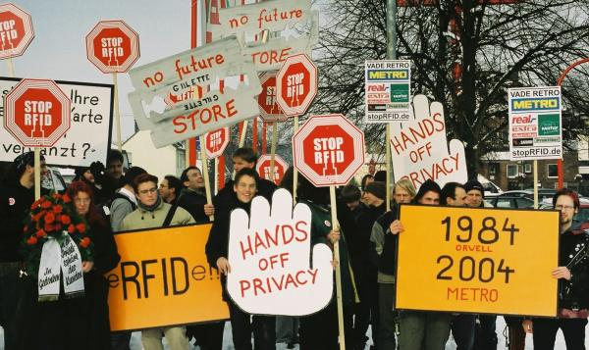
Security and privacy issues: consumers, policy makers, researchers
Pricing: very low
Standards landscape

Slide 50
Transport and logistics: toll management, tracking of goods Security and access control tracking people (students etc.), control access to restricted areas
Supply chain management: item tagging, theft-prevention
Medical and pharmaceutical applications: identification and location of staff , students and patients, asset tracking, forging protection for drugs
Marathon runners wear tags on their shoes to record their race times; drivers use tags in their cars to pay tolls automatically.

Slide 51
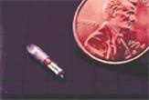
Proposal to Implant Tracking Chips in Immigrants
Scott Silverman, Chairman of the Board of VeriChip Corporation, has proposed implanting the company's RFID tracking tags in immigrant and guest workers. He made the statement on national television on May 16

Slide 52
V Software: Text Mining
Text-mining software is one of the front-line tools that the government is now using to ease out valuable connections.
These specialized search engines can quickly shift through mountains of unstructured text—anything that's not carefully arranged in a database or spreadsheet—and pull out the meaningful stuff.

Slide 53
It is something we do all the time automatically but is enormously complicated for computers. “It bridge the gap between information and action."
More government agencies, including the Defense Intelligence Agency, the Department of Homeland Security, and the FBI, are using them to evaluate the multitude of e-mail messages, phone call transcripts, memos, foreign news stories, and other pieces of intelligence data these agencies collect each day.

Slide 54
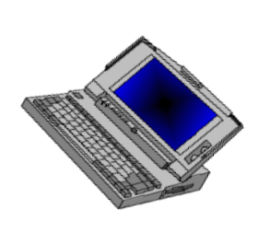
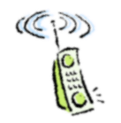
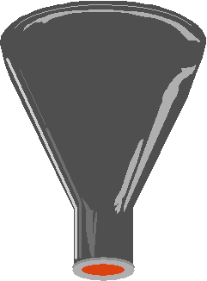
It is necessary to automatically analyze, organize, summarize... Information.
Text Mining
Knowledge

Slide 55
Recycling: Reverse Engineering
Over the next three years, 250 million computers are expected to become obsolete, according to the Environmental Protection Agency
Old PCs can quickly become harmful PCs. A typical computer monitor, for example, contains between 2 and 4 pounds of lead, which can leach into the groundwater in a landfill.

Slide 56
The problem is severe : Do you know that in USA alone?
Between 1997 and 2007, nearly 500 million personal computers will become obsolete-almost two computers for each person.
15,000,000 PCs become obsolete every year.
7,000,000 computers will end up stored for at least 3 years.
750,000 computers will end up in landfills this year alone.
85% of the 63 million computers taken out of service in the U.S. end with landfills, according to the National Safety Council.

Slide 57
Robotics: Cognitive Machines
Today's robots are a like sweeper.
They can perform programmed tasks but can't think for themselves.
These control everything from Cog's arm, neck, and head movement to its voice and its eyes, which capture and interpret action at 30 frames per second.
Under the guidance of lab director Rodney Brooks, a project's is proposed develop Cog with the thinking abilities of a 3-year-old.

Slide 58

The ultimate goal is to have Leonardo (or another robot like it) pick up on cues, respond to ever-changing situations, and interact with people naturally.

Slide 59
Entertainment: Social Gaming
Gaming is a bigger industry than movies.
Gaming is becoming an increasingly social activity.
IDSA finding shows that nearly 60% of gamers playing with friends, 33% with siblings, and about 25 % with spouses or parents.

Slide 60
Energy: Fuel Cells
The long-lasting, environment friendly fuel cell is one of the most hotly pursued technologies of the decade.
"There is an energy revolution happening that is similar to what we saw with the PC revolution,"
"Moore's Law has set in with fuel cells,“ referring to the falling cost and increased efficiency of fuel cell technology.

Slide 61
Toshiba recently demonstrated a prototype of a direct methanol fuel cell that can power a notebook, PC for 5 hours works by converting chemical energy directly into electricity.
NEC is a front runner - building a fuel cell based on carbon nano-tubes that is small enough to power handhelds and cell phones.
Ford Motor Company is investing $420 million to produce a commercial hydrogen-powered car by next year.
USA earmarked $1.2 billion for a hydrogen fuel cell initiative.

Slide 62
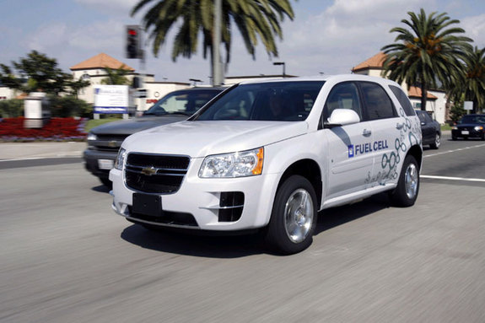
More than 100 Chevrolet Equinox Fuel Cell electric vehicles will be deployed by General Motors in the streets of AMERICA to market test of fuel cell vehicles of its kind (2007)

Slide 63
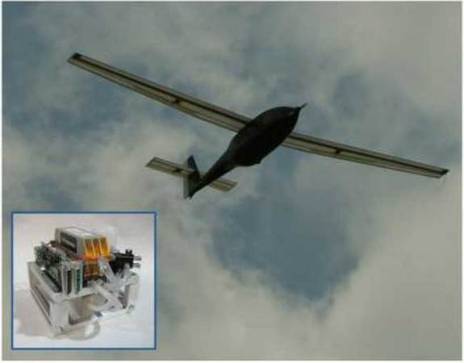
The U.S. Navy has developed a hydrogen-powered aircraft that can fly for nearly an entire day without refueling.

Slide 64
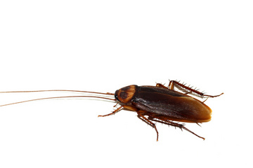
Cockroach get their own power source.
The secret is an implantable biofuel cell powered by a sugar make from their food.

Slide 65
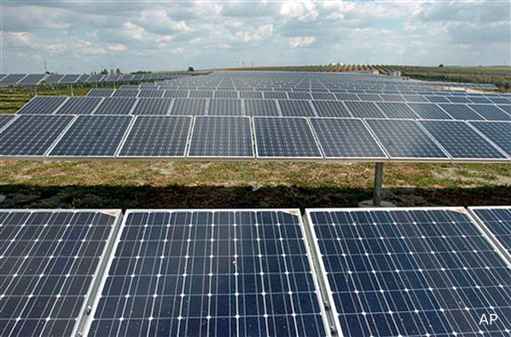
Futurist and inventor Ray Kurzweil is part of distinguished panel of engineers.
He predicts that the solar power will scale up to produce all the energy needs of Earth's people in 20 years.

Slide 66
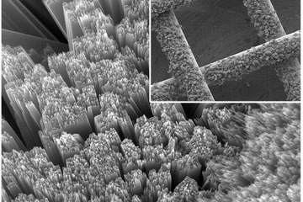
New solar nano carbon tube battery could generate cheaper clean energy
October 17th, 2014

Slide 67
Materials: Plastic Transistors
Today, plastics are the future of the $30 billion computer display market, and they may even lead to new breeds of computer memory and microprocessors.
Within five years, using plastics with organic light-emitting diode technology ( "OLED ) and organic transistors, to build flexible displays.
Eventually, plastics could be used to build entire machines that you can bend and drop without breaking.

Slide 68
"These devices will be so flexible and light can integrate them directly onto almost any type of matter we want, including a piece of clothing”.
Scientists at Bell Labs and Xerox have found ways of using organic materials rather than silicon to build electronics.
IBM researcher who's worked on plastic electronics for the past five years. And they may be even cheaper than silicon-based devices.

Slide 69
Materials: OLED Displays
OLED (Organic Light Emitting Diode)
An OLED uses a carbon-based molecule that emits light when an electric current passes through it.
Piece consists of lot of molecules together and get a super thin display of stunning quality—no power-draining backlight required.
OLED displays can be produced in the same way an ink jet printer sprays ink onto a sheet of paper, making manufacturing cheap and simple.

Slide 70
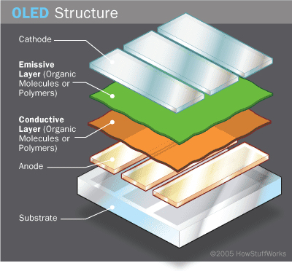
Architecture of OLEDs
  Organic layer:
    Conducting layer - This layer is made of organic plastic molecules that transport "holes" from the anode. One conducting polymer used in OLEDs is polyaniline.
    Emissive layer - This layer is made of organic plastic molecules that transport electrons from the cathode; this is where light is made.

Slide 71
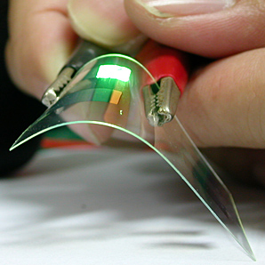
OLED is an light emitting diode (LED) which emissive electroluminescent layer is composed of a film of organic compounds.

Slide 72
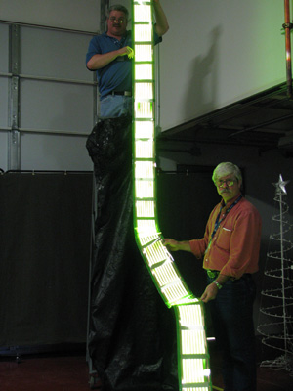
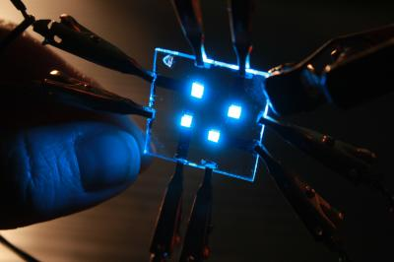
Current Research for OLEDs
  Manufacturers focusing on finding a cheap way to produce "Roll-to-Roll“ OLED. .

Slide 73
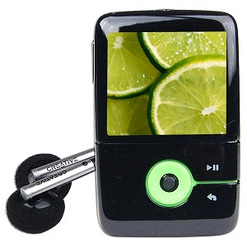
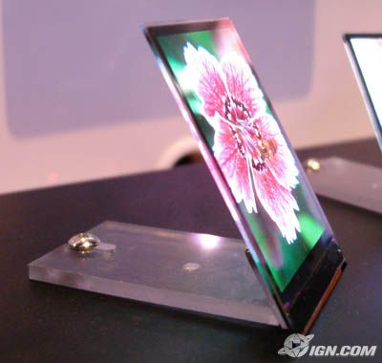
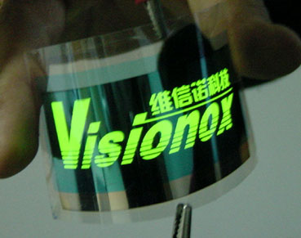
Applications of OLEDs
  Vs
  Cell Phone screens
  Computer Screens
  Keyboards
  (Optimus Maximus)
  Portable Divice displays

Slide 74
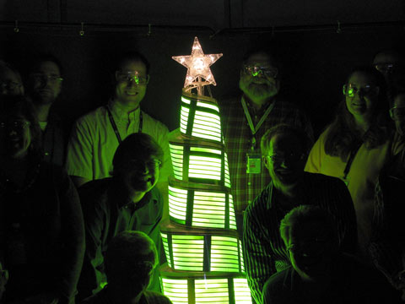
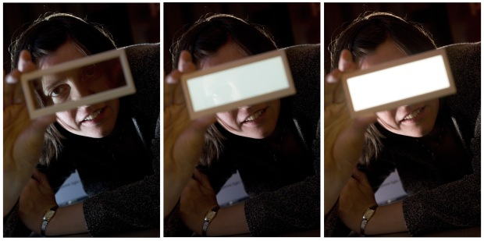


OLEDs as a Light Source

Slide 75

OLED Televisions
  First OLED TV (SONY)sold in stores.
  11'' screen, 3mm thin
  $2,500 MSRP
  Weighs approximately 1.9 kg
  Wide 178 degree viewing angle
  1,000,000:1 Contrast ratio.

Slide 76


Maximus Keyboard
  Small OLED screen on every key total 113 OLED screens.
  Each key can be programmed to perform a series of functions
  Keys can be linked to applications
  Display notes, numerals, special symbols, HTML codes, etc…SD card slot for storing settings

Slide 77

Advantages of OLEDs
OLED Displays Vs. LCD and Plasma
  Able to display "True Black" picture
  Wider viewing angles
  Thinner display
  Better contrast ratio
  Safer for the environment
  Has potential to be mass produced inexpensively
OLED Lighting Vs. Incandescent and Fluorescent
  Cheaper way to create flexible lighting
  Requires less power
  Better quality of light (ie. no "Cold Light")
  New design concepts for interior lighting

Slide 78


Future Uses for OLED
Lighting
  Flexible / bendable lighting
  Wallpaper lighting defining new ways to light a space
  Transparent lighting doubles as a window

Slide 79


Future Uses for OLED
Using Samsungs' transparent OLED technology
  Heads up display
  GPS system
Scroll Laptop

Slide 80
Wireless: Mesh Networks
The term 'wireless mesh networks' describes wireless networks in which each node can communicate directly with one or more peer nodes.
Still, this is quite different than traditional wireless networks, which require centralized access points to mediate the wireless connection.

Slide 81
Wireless: Mesh Networks
Nodes are comprised of mesh routers and mesh clients.
Each node operates not only as a host but also as a router, forwarding packets on behalf of other nodes that may not be within direct wireless transmission range of their destinations.
A WMN is dynamically self-organized and self-configured, with the nodes in the network automatically establishing and maintaining mesh connectivity among themselves

Slide 82
WMNs consist of two types of nodes:
Mesh Routers and Mesh Clients.
A wireless mesh router contains additional routing functions to support mesh networking.
It is equipped with multiple wireless interfaces built on either the same or different wireless access technologies.
A wireless mesh router can achieve the same coverage as a conventional router but with much lower transmission power through multi-hop communications.

Slide 83

WMN COMPONENTS
Examples of mesh routers based on different embedded
systems:
(a) PowerPC and
(b) Advanced Risc Machines (ARM)

Slide 84

WMN COMPONENTS
Examples of mesh clients: (a) Laptop, (b) PDA,
(c) Wi-Fi IP Phone and (d) Wi-Fi RFID Reader.

Slide 85




WMN COMPONENTS

Slide 86




WMN COMPONENTS

Slide 87
What is Nanotechnology?
Nanotechnology is the creation and use of materials or devices at extremely small scales.
1 nm = 0.000000001 m
Notes:
Nanotechnology deals with the development and use of materials or devices in sizes ranging between 1 to 100 nanometers (nm). This range is known as the nanoscale. All materials that fall along this scale are known as either nanocrystals and nanomaterials.

Slide 88



What is Nanoscale?
ww.mathworks.com
Fullerenes C₆₀
www.physics.ucr.edu
0.7 nm
12,756 Km
22 cm
1.27 × 10⁷ m
0.22 m
0.7 × 10⁻⁹ m
10 millions times smaller
1 billion times smaller

Slide 89

Materials behave differently at this size scale.
It’s not just about miniaturization.
At this scale---it’s all about INTERFACES
Size Matters!
Color depends on particle size
Quantum dots 3.2 nm in diameter have blue emission
Quantum dots 5 nm in diameter have red emission

Slide 90

Size dependent properties of cadmium selenide:
Colour of nanophase materials vary according to
the size of their constituent grains, or clusters.
white light (left) and ultraviolet light (right).

Slide 91


Thermal Conductivity
Si phonon thermal conductivity: Bulk vs. Micro scale
Room-temperature thermal conductivity data for silicon layers as a function of their thickness.
Thermal conductivities of the silicon device layers with thicknesses 0.42, 0.83, and 1.6 μm.
Asheghi, A., Touzelbaev, M.N., Goodson, K.E., Leung, Y.K., and Wong, S.S., 1998, “Temperature-Dependent Thermal Conductivity of Single-Crystal Silicon Layers in SOI Substrates,” ASME Journal of Heat Transfer, 120, 30-36.

Slide 92
Nanoscale Size Effect
Attainment of high surface area to volume ratio
Change in properties, including changes in:
  - Physical Properties (e.g. melting point)
  - Chemical Properties (e.g. reactivity)
  - Electrical Properties (e.g. conductivity)
  - Mechanical Properties (e.g. strength)
  - Optical Properties (e.g. light emission)

Slide 93
…Nanoscale Size Effect
Magnetic materials like iron loses its magnetism at nano-size.
Gold shines as a metal and non-reactive. At nano, chemically reactive.
Melting point of solid changes with size of particle.

Slide 94

Nanopowder are transparent to visible light.

Slide 95


Slide 96

How can Nanotechnology help us?
Nanotechnology will help us :
1. Develop new manufacturing technology
2. Help us build computer systems inexpensively with mole quantities

Slide 97
Recycling: Reverse Engineering
Over the next three years, 250 million computers are expected to become obsolete.
[According to the Environmental Protection Agency]
Old PCs can quickly become quickly obsolete. A typical computer monitor, for example, contains between 2 and 4 pounds of lead, which can leach into the groundwater in a landfill.

Slide 98




Slide 99

With 15,342 atoms, this parallel-shaft speed reducer gear is one of the largest nano-mechanical devices ever modeled in atomic detail.

Slide 100
Thank you for
your attention!

